Slide 1
Sharing within the same organization/same Snowflake account
Secure Data Sharing
enables read-only access to live data without moving or copying it. Data providers create a share, grant access to specific database objects (tables, secure views), and add consumer accounts, typically within the same region.
Key Concepts for Same-Org/Account Sharing
No Data Movement: Shared data is live; updates in the provider account are immediately visible to consumer accounts.
Storage & Compute Costs: The provider pays for storing the shared data, while the consumer pays for the compute resources used to query the data.
Read-Only Access: Shared databases are read-only. Consumers cannot modify data or create new objects in the shared database.
Scope: Sharing is typically intended for different Snowflake accounts within the same region.

Slide 2
Sharing within a cloud region
Direct Shares
Direct Shares provide instant, read-only access to live data without moving or copying it. Both provider and consumer accounts must exist in the same region, allowing for 1:1 or 1:Many sharing.
Please note that consumer will only pay for compute costs.
Key Aspects of Same-Region Sharing:
Performance & Cost: Zero-copy cloning eliminates storage costs for shared data; data is not moved or copied, ensuring live updates.
Security: Data is shared directly from the provider database to the consumer account. Secure views can be utilized to restrict access.
Mechanism: Providers create a share, add objects (tables, secure views), and grant access to specific consumer accounts.
Limitations: Shared databases are read-only and cannot be re-shared.

Slide 3
Sharing across cloud regions
It enables secure access across different cloud providers (e.g., AWS to Azure). This process involves creating replication groups to sync databases, creating shares from the replicated data, and using Listings for easy consumption.
DATABASE REPLICATION
Key Concepts & Steps
Replication Groups: You must use replication groups to add databases and shares for replication to target regions.
Enable Replication: An organization administrator must enable replication for both the source and target accounts.
Replicated DB to Share: The data must be replicated to the secondary region before it can be shared, as direct sharing is limited to the same region.
Listings: The easiest way to share data across regions and cloud providers is using Snowflake Listings, which supports auto-fulfillment and cross-region sharing.

Slide 4
Sharing between different Snowflake accounts
enables secure, real-time sharing without copying data. Data providers create a listing, which then can be shared across different regions or clouds, while consumers access this via read-only. The process involves sharing metadata via the services layer, where the provider grants access to specific databases/views, and the consumer creates a database from that share.
Snowflake Data Listings
Key Aspects of Cross-Organization Sharing
Listings & Direct Share: While direct sharing works within the same region, Data Listings are typically used for sharing across different organizations and regions.
No Data Movement: Data remains in the provider's account. Consumers query data using their own compute resources, with no data storage costs for the consumer.
Setup Requirements: The provider defines a share, grants SELECT privileges on specific objects (tables/views) to that share, and grants USAGE on the database/schema.
Consumer Access: The consumer creates a new database from the shared listing to access the data.
Security & Control: Data is shared read-only. The provider can revoke access at any time.
Cross-Region/Cloud: For cross-region sharing, the provider might need to use replication to move data to the consumer's region, or rely on listing mechanisms that handle cross-cloud functionality.

Slide 5
Sharing to a non-Snowflake customer
Reader Accounts
It allows us to create a secure, read-only Snowflake account for non snowflake users. The provider covers the costs, and it enables real-time access to shared data without requiring the recipient to have their own Snowflake contract.
Sharing across cloud providers
Snowflake Data Listings
DATABASE REPLICATION
It’s achieved by replicating data to the target region and using Snowflake's secure data sharing features i.e. Listings. This allows for zero-copy sharing or replicated sharing, reducing the need for ETL. The process involves setting up replication, creating shares from the replicated database, and managing access control.
Key Aspects of Cross-Cloud Sharing
Replication Needed: Data must be replicated to the target cloud/region to allow access, enabling sharing across AWS, Azure, or GCP.
Secure Data Sharing: Replicated databases are used to create shares, allowing consumers to query data without moving it.
Snowflake Listings: This approach supports automatic fulfillment, enabling data sharing across clouds, with options to monitor usage and charge for data access.
Direct Share: While mainly for same-region sharing, it can be combined with replication for cross-cloud scenarios.
Governance: Fine-grained access control and security are maintained throughout the process.

Slide 6
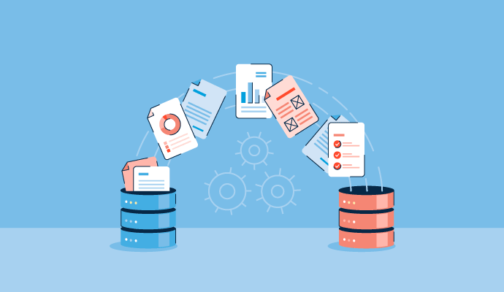
Data Exchange
Data Exchange provides a data hub for securely collaborating around data with a selected group of members that you invite. It lets you, as a provider, publish data which can then be discovered by the consumers participating in your exchange.
With a Data Exchange, you can easily provide data to a specific group of consistent business partners taking part in the Data Exchange, such as internal departments in your company or vendors, suppliers, and partners external to your company. If you want to share data with a variety of consumers inside and outside your organization, you can also use listings offered to specific consumers or publicly on the Snowflake Marketplace.

Slide 7
Configure shares, account parameters, and privileges
The Privilege Chain
To share an object, the provider role (usually ACCOUNTADMIN or a role with CREATE SHARE) must follow this sequence:
GRANT USAGE ON DATABASE <db> TO SHARE <share_name>;
GRANT USAGE ON SCHEMA <db>.<schema> TO SHARE <share_name>;
GRANT SELECT ON <table/view> TO SHARE <share_name>;
Critical Account Parameters
DATA_RETENTION_TIME_IN_DAYS: If you drop a shared table, it disappears for the consumer instantly. Ensure retention is set high enough on source tables to prevent accidental outages.
SHARE_RESTRICTIONS: You can restrict which regions or accounts can view your shares.

Slide 8
Security patterns for data sharing
Secure Views (Non-negotiable)
Standard views allow a user to run GET_DDL or use "under-the-hood" optimizations to guess data in rows they shouldn't see.
Pattern: Always use CREATE SECURE VIEW for sharing. It prevents the consumer from seeing the underlying logic and stops certain query optimizations that could leak data.
B. Row-Level Security (Multi-tenant Pattern)
If you have one massive SALES table but want 50 different consumers to only see their data, use a Mapping Table.
For Eg:-
CREATE SECURE VIEW shared_sales_data AS
SELECT s.*
FROM sales_table s
JOIN account_mapping_table m ON s.account_id = m.account_id
WHERE m.snowflake_account_name = CURRENT_ACCOUNT();

Slide 9
Outline the purpose, benefits, and capabilities of the multiple data sharing methods
Method | Purpose | Key Capability
Direct Sharing | 1-to-1 or 1-to-many sharing within the same region. | Instant access to provider's metadata; zero storage cost for consumer.
Data Marketplace | Publicly listing datasets for many consumers. | Monetization, automated discovery, and simplified access.
Private Exchange | A "walled garden" for a specific group of partners. | Branding, custom membership, and centralized auditing.
Reader Accounts | Sharing with non-Snowflake customers. | Provider-managed/billed accounts for external access.

Slide 10
Cross-Cloud Auto-Fulfillment
Auto-Fulfillment is the managed service layer on top of Replication.
The Mechanism
Auto-fulfillment automates the "Global Data Mesh." When a consumer in a different cloud/region requests data from your Listing:
Snowflake automatically creates a hidden replication group.
It replicates the data to that region.
It keeps the data in sync based on a "Freshness Goal" (e.g., every 1 hour).
Checklist for Auto-Fulfillment:
Cost: The Provider pays for the Data Transfer (egress) and the Storage in the remote region.
Editions: Business Critical (or higher) is often required for certain failover/failback replication features, but standard cross-cloud sharing is available via Listings.
Efficiency: It only replicates the data once per region, regardless of how many consumers in that specific region "get" the data.

